Slide 1

DATA SCRAPING USING BLUE PRISM
Project Supervisor: Dr. M. Maheswari.
Name of the Student: Ms. Supriya Sinha
Register Number: 38110579

Slide 2
Presentation Outline
Introduction
Objectives
System Architecture / Ideation Map
Module Implementation
Hardware & Software Requirements
Methodology
Results and Discussions
Conclusion & Future work
References

Slide 3
Introduction
Easy to build, deploy, and manage software robots with digital systems and software.
Scrapes item searches of flipkart by reading the data from the website by automatically launching using the Blueprism software.
Gets the accurate data from the web as it changes in real-time.

Slide 4
Objectives
The main objective of this project is to scrape the data from the real time Website with higher accuracy.
Accelerate the process, boost the productivity, free people from repetitive tedium across several sectors.
Aim to collect data at any stage and save resources and time.

Slide 5
System Architecture / Ideation Map
Start
Auto Launch of Flipkart website
Reads the data
Displays the output
Checks the condition
Stores the data in data items
End

Slide 6
Module Implementation
Launch Module
Wait – Time Module
Read Module
Count Module
Decision Module
Collection Module

Slide 7
Hardware & Software Requirement
Hardware Requirements
Processor
Ethernet Connection (LAN) or Wireless Adapter (Wi-Fi)
Hard Drive
Memory (RAM)
Software Requirements
Operating System: MAC OS, Windows, etc.
Web Browsers
Blue Prism Software + Licence Key

Slide 8
Methodology
With RPA as such fast technology, in this project the data will be extracted from the flipkart by auto launching the website.
This project is expected to perform several operations using different stages and actions such as Navigate, Collection, Decision, Anchor, etc.
At first, it will perform the auto launch of the website by using the Navigate stage where it launches the website after a particular time limit.
Then it will extract the data using different data items.
At last, it will store the data extracted in the collection stage. All of these have been implemented using the Blue Prism software tool.

Slide 9
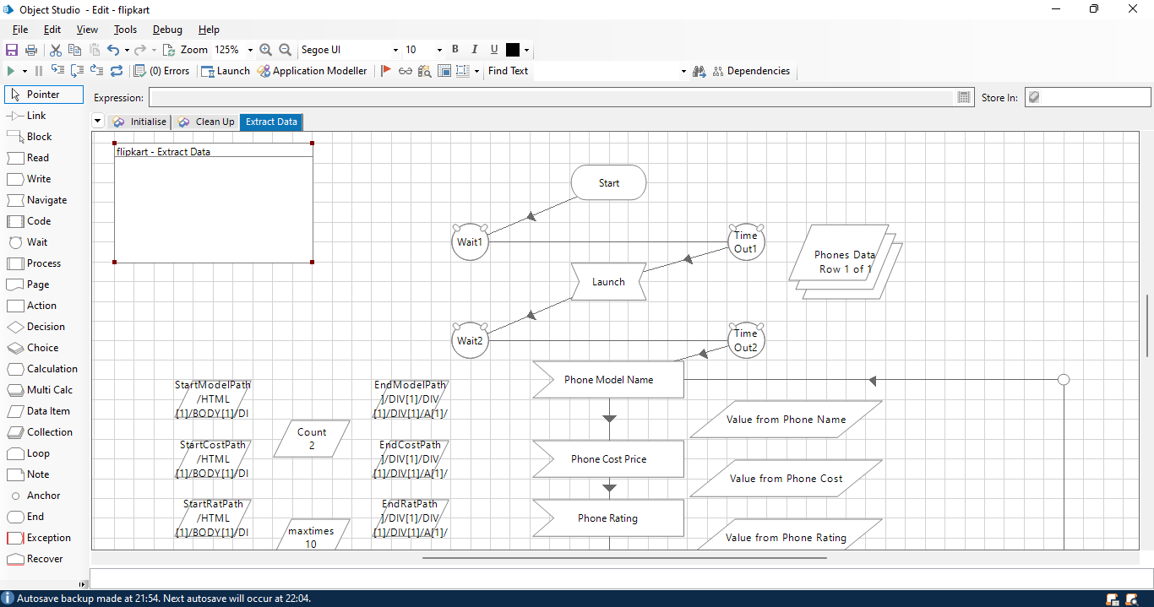
Results and Discussion

Slide 10
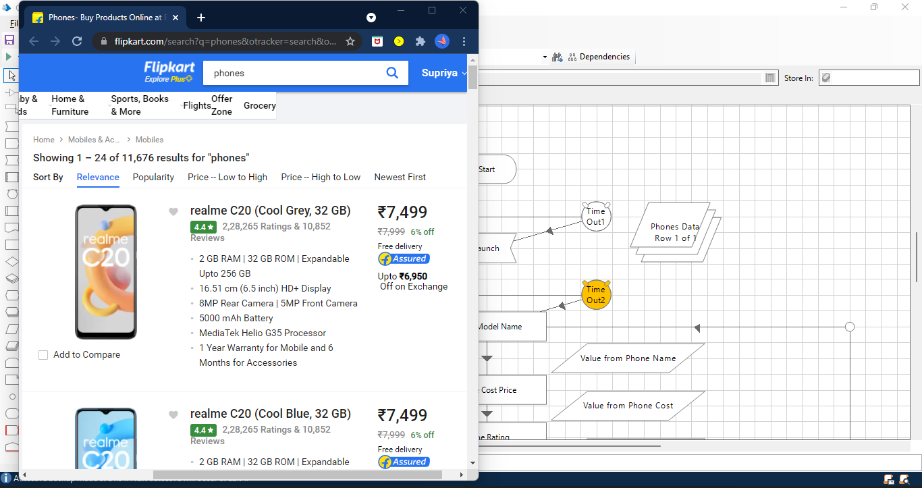

Slide 11
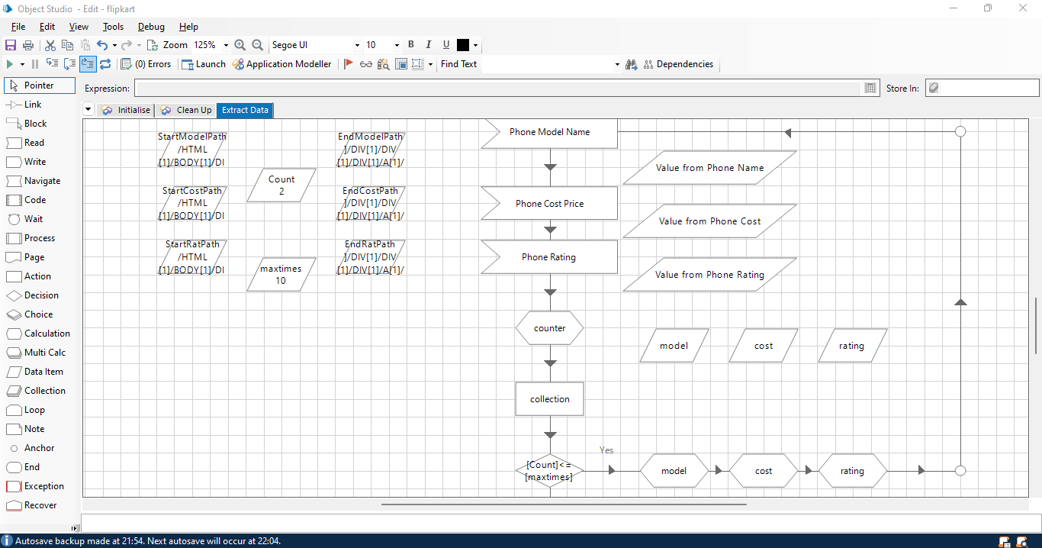

Slide 12
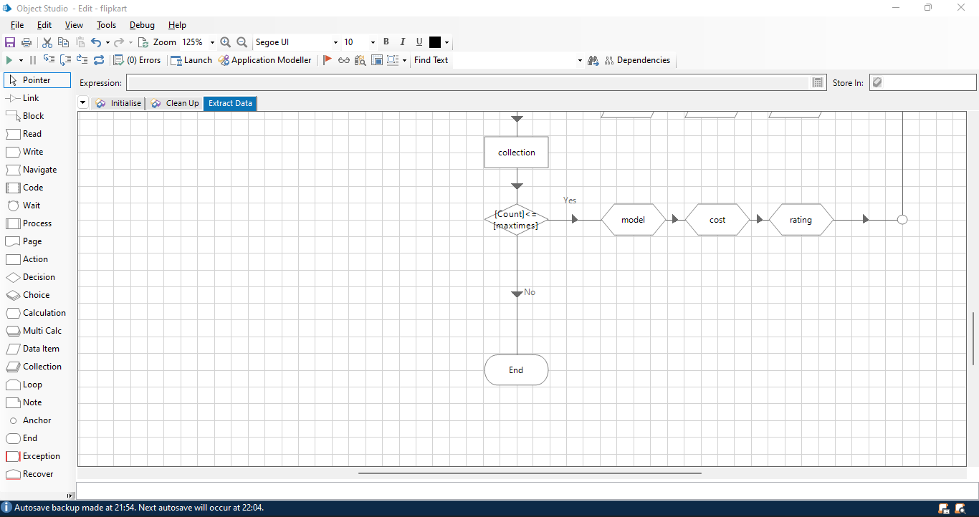

Slide 13
Conclusion
Software technology (RPA) makes it easy to build software robots with no -code.
It can do things like understand what is there on screen, complete the right keystrokes, navigate systems, identify, extract data and perform wide range of defined actions.
On successful implementation of the project it can be implemented in all major applications which can make organizations more profitable, flexible and responsive.
Increased employee satisfaction, engagement and productivity can lead to great implementation.

Slide 14
References
RPA Smart Internz Program
https://smartinternz.com/blueprism-rpa-bootcamp
Blueprism University
https://www.blueprism.com/
Robotic Process Automation
https://en.wikipedia.org/wiki/Robotic_process_automation
Robotic Process Automation – Intro
https://www.uipath.com/rpa/robotic-process-automation

Slide 15
The End
DATA SCRAPING USING BLUE PRISM
Questions & Answers

